Slide 1
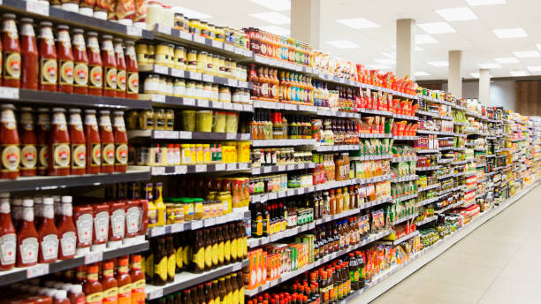
Sales forecasting and inventory management
Thanks to Steve Mitchell for mentoring

Slide 2
Motivation
Forecasts:
help reduce costs and improve Customer Service Level.
drive to better trade-off between cost of excess and cost of shortage in inventory management.
help build efficient long planning horizon
facilitate management with data-driven decisions

Slide 3
Project scope
The goal is to use Machine Learning and forecasting techniques to manage inventory of a grocery retailer. It has 54 retail stores and 33 different groups of products. The task is to model the behaviors of 1782 time series for forecasting.
The dataset used come from Corporación Favorita, a large Ecuadorian-based grocery retailer. Thanks to Kaggle for making this dataset available for free.

Slide 4
Table of contents
Overview on the demand
Monthly sales forecast at different stores
Monthly sale forecast at different stores for different categories of products
Daily sales forecast at different stores
Daily sales forecast at different stores for different categories of products
Improvement on the model
Conclusion

Slide 5
Overview on the demand
Weekly seasonality factors/days
Annual seasonality/month
Days | Factors
Monday | 0.97
Tuesday | 0.90
Wednesday | 0.94
Thursday | 0.79
Friday | 0.91
Saturday | 1.21
Sunday | 1.28
Months | Factors
January | 1.08
February | 0.98
March | 1.08
April | 1.11
May | 1.15
June | 1.15
July | 1.21
August | 0.96
September | 0.76
October | 0.79
November | 0.79
December | 0.94
Global tendency

Slide 6
Overview on the demand
Sales by store types
Sales by product categories
Type | Sales share | # store/54
A | 32.27 | 9
B | 14.00 | 8
C | 15.00 | 15
D | 32.58 | 18
E | 6.15 | 4
Categories | Sales share
Grocery I | 30.32
Beverages | 21.30
Produce | 13.70
Rest (30 categories) | 34.68
65.32% of the sales within 3 categories of product
2 types of store lead the sales ranking

Slide 7
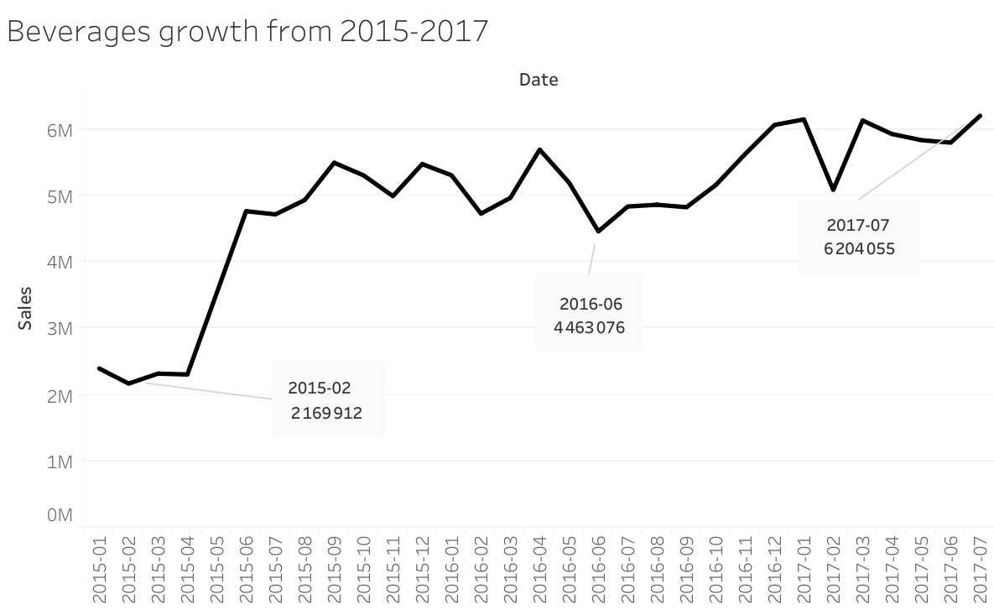
Overview on the demand

Slide 8
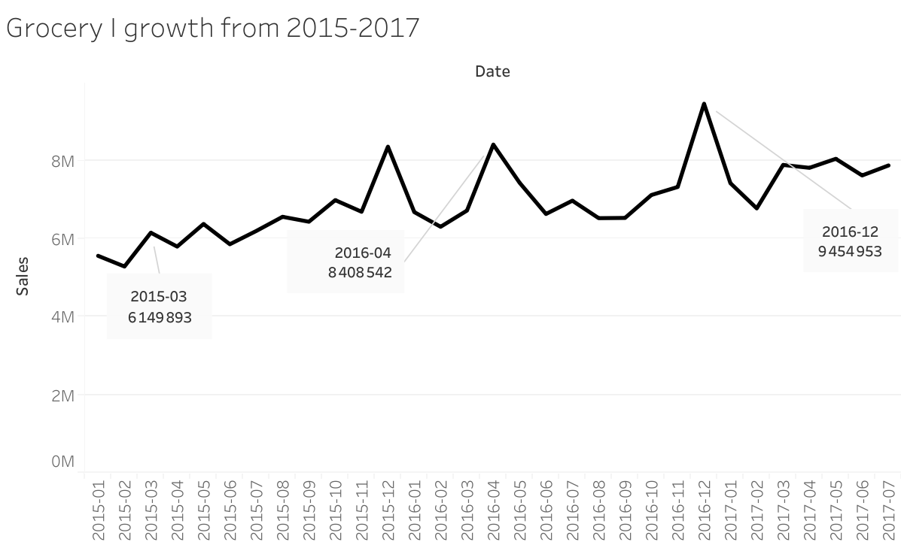
Overview on the demand

Slide 9
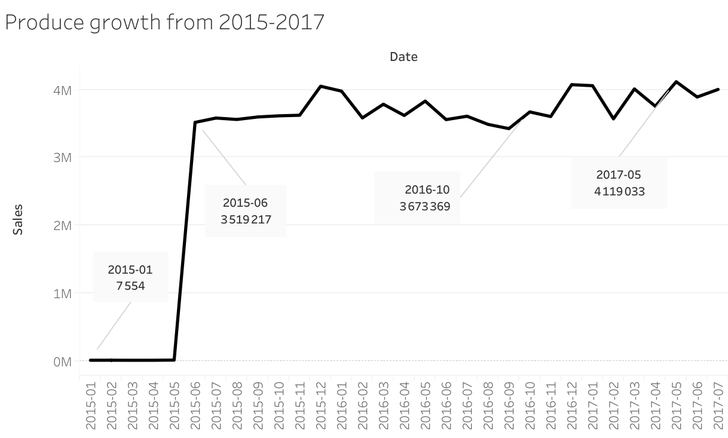
Overview on the demand

Slide 10
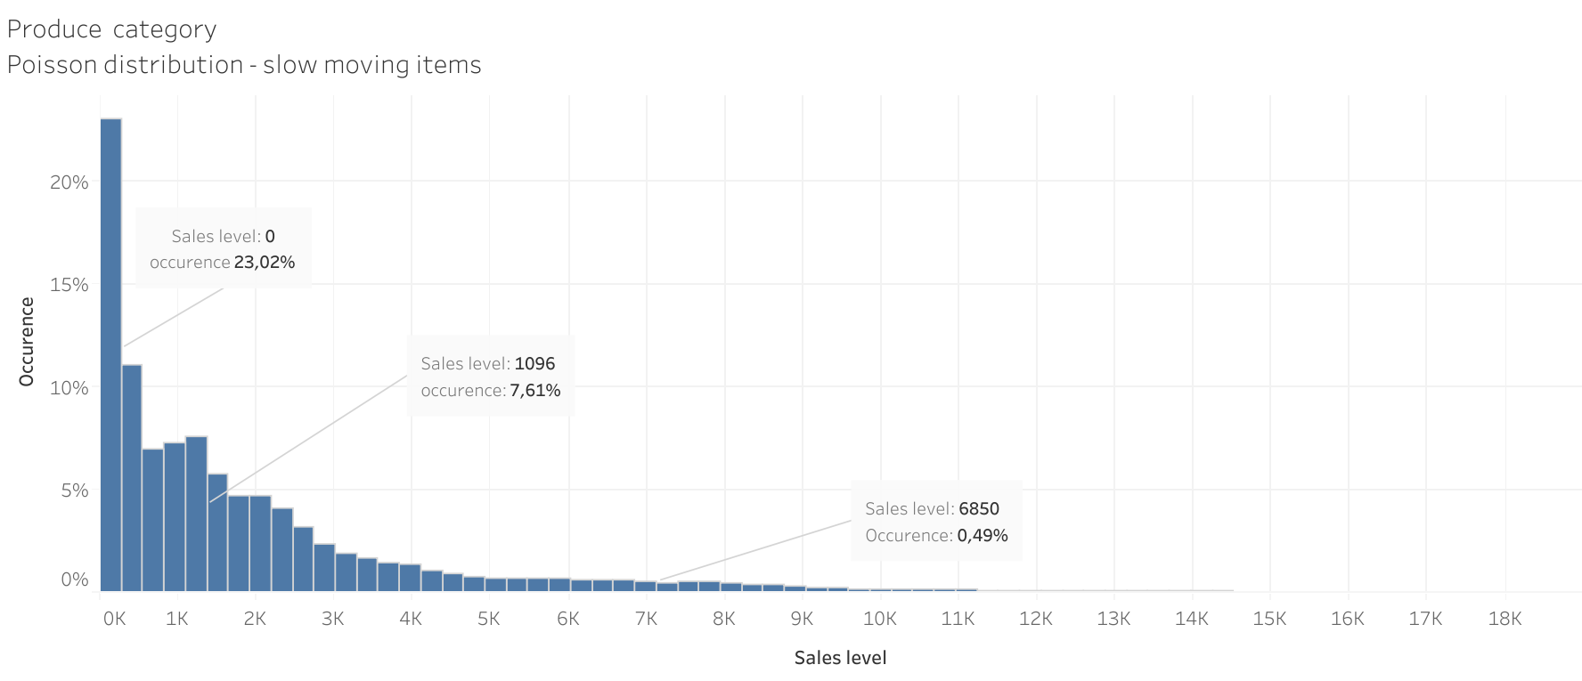
Overview on the demand

Slide 11
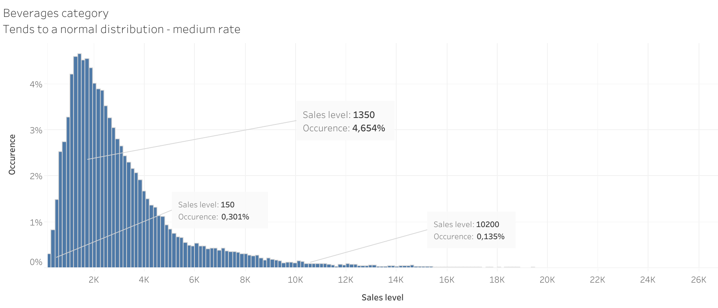
Overview on the demand

Slide 12
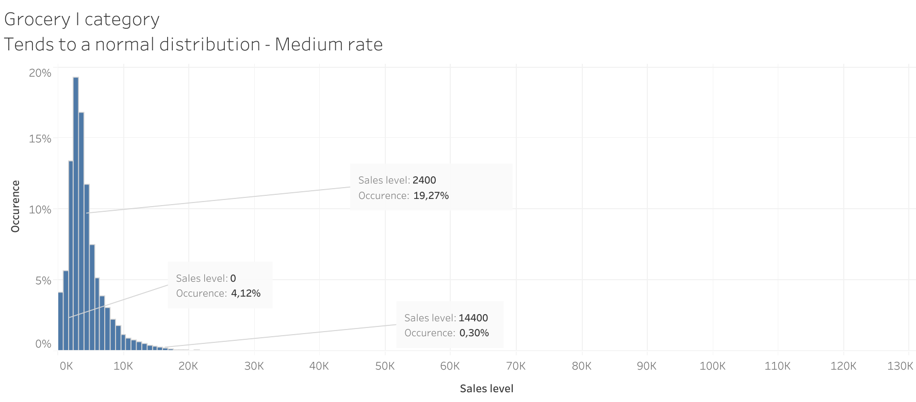
Overview on the demand

Slide 13
Monthly sales

Slide 14
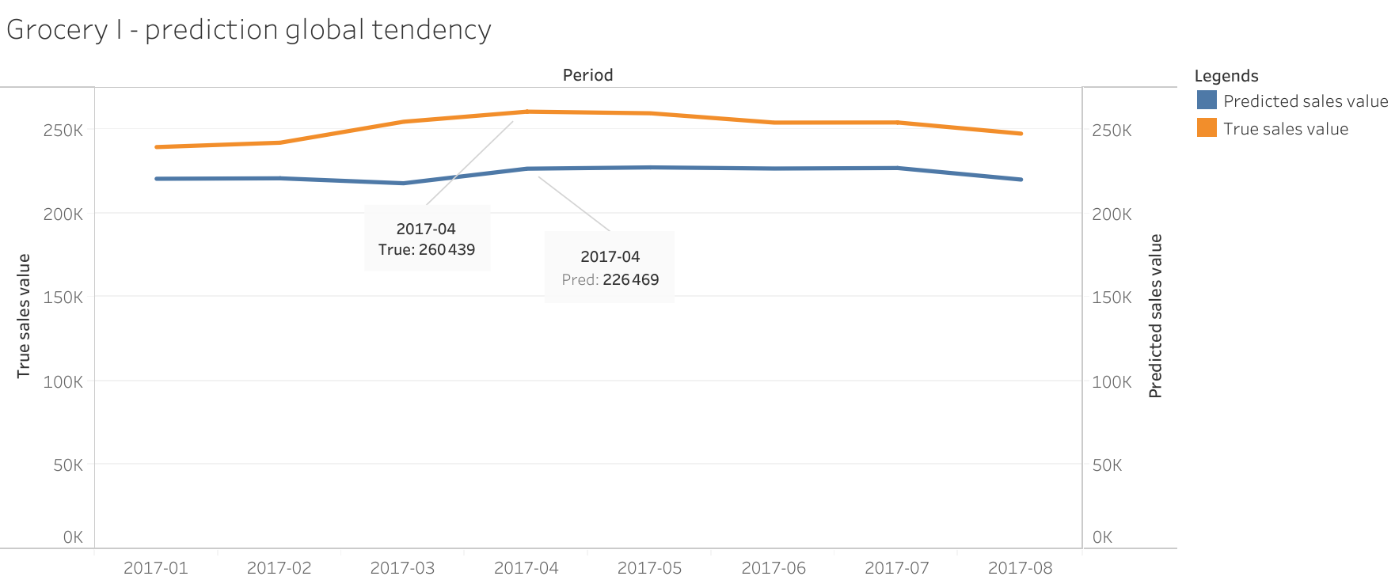
Monthly sales forecast at different stores
Random Forest Regressor
At all stores

Slide 15
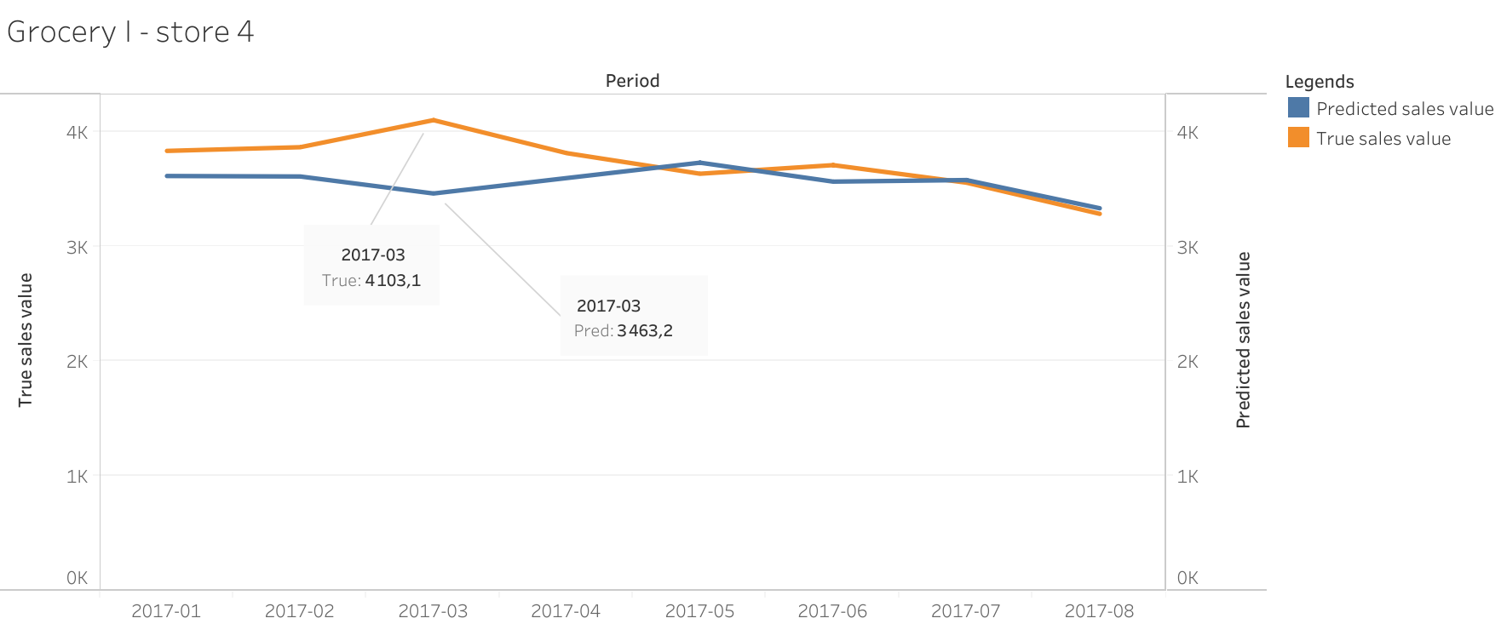
Monthly sales forecast at different stores

Slide 16
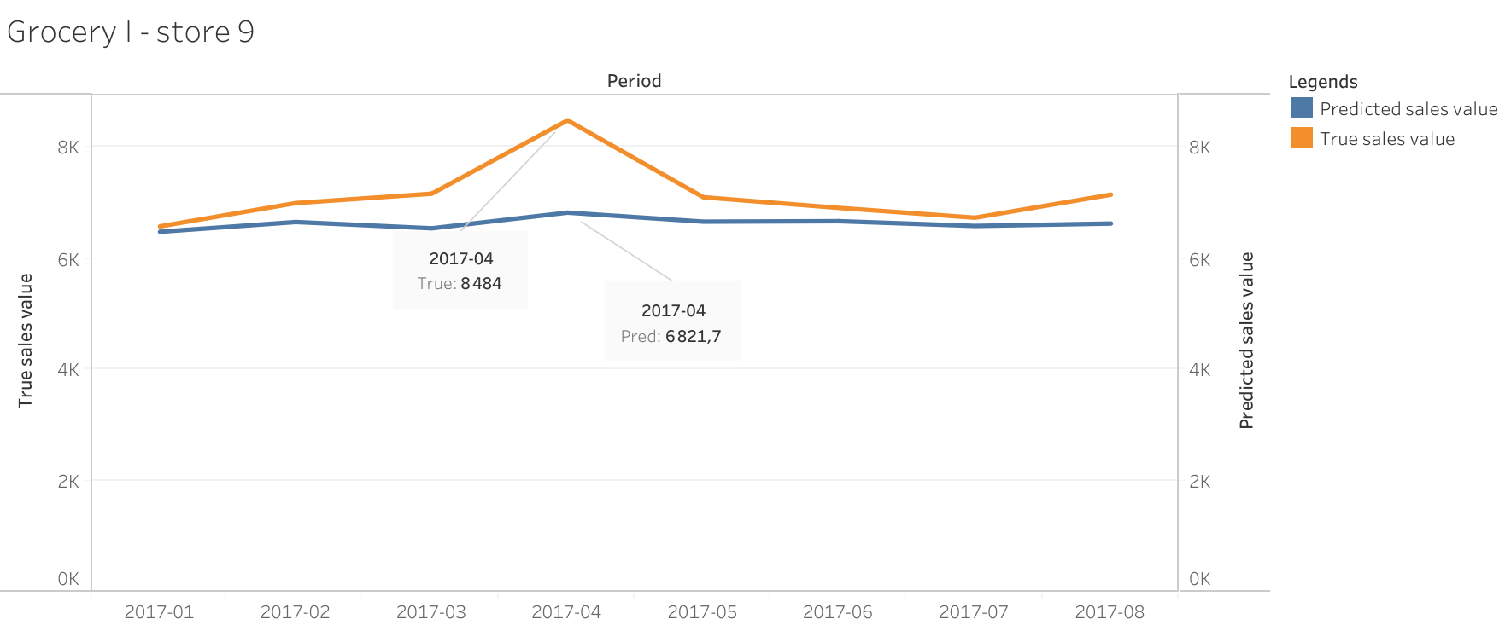
Monthly sales forecast at different stores

Slide 17
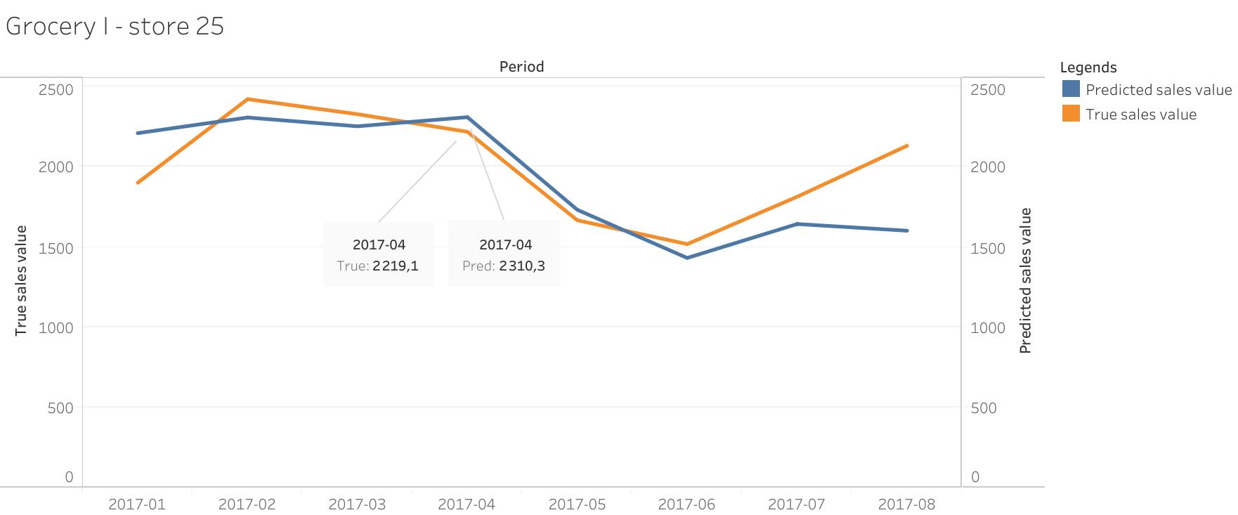
Monthly sales forecast at different stores

Slide 18
Monthly sales forecast at different stores
Model performance for “GROCERY I” category by store
Error percentage % | Model accuracy
5 | 28.90
10 | 56.87
15 | 80.09
20 | 91.20

Slide 19
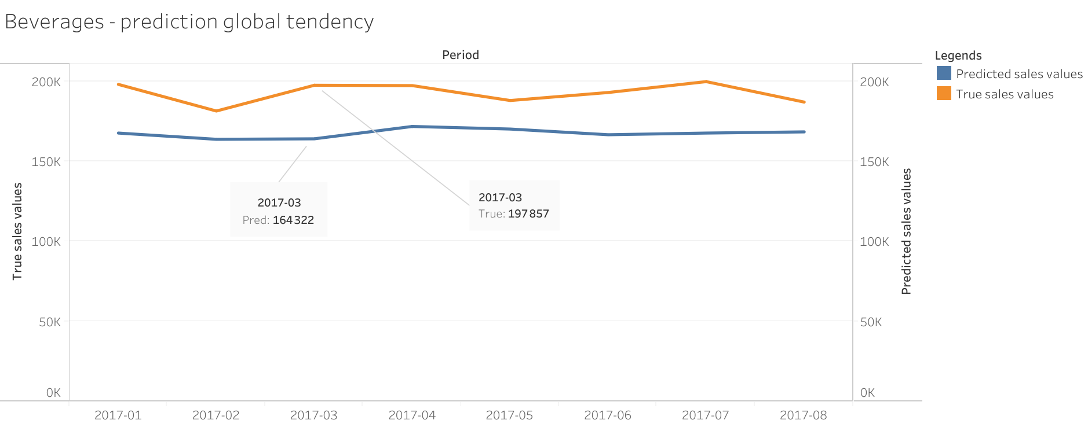
Monthly sales forecast at different stores

Slide 20
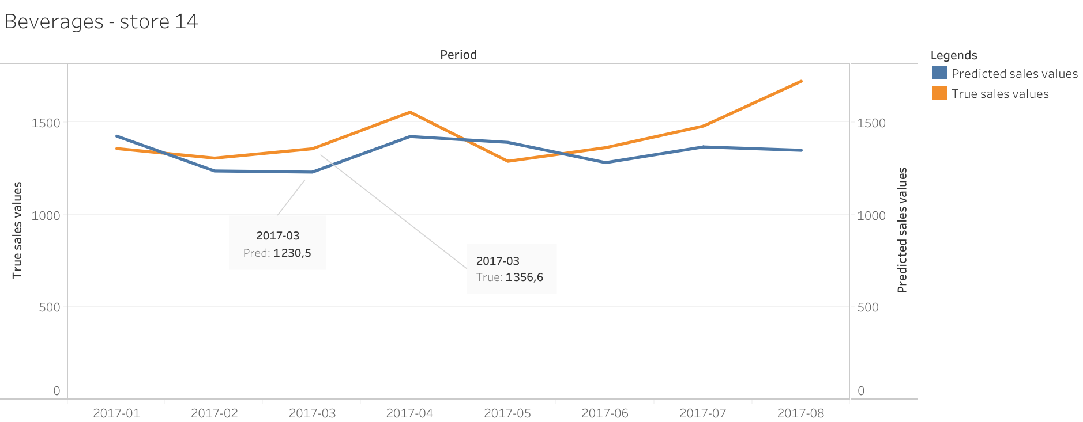
Monthly sales forecast at different stores

Slide 21
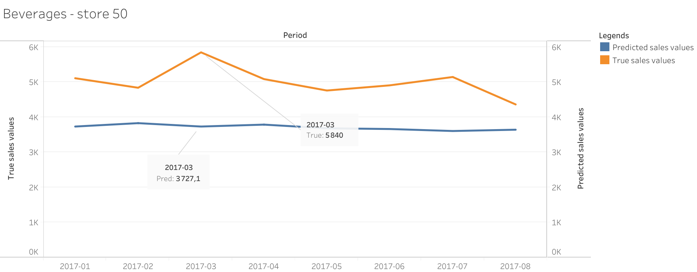
Monthly sales forecast at different stores

Slide 22
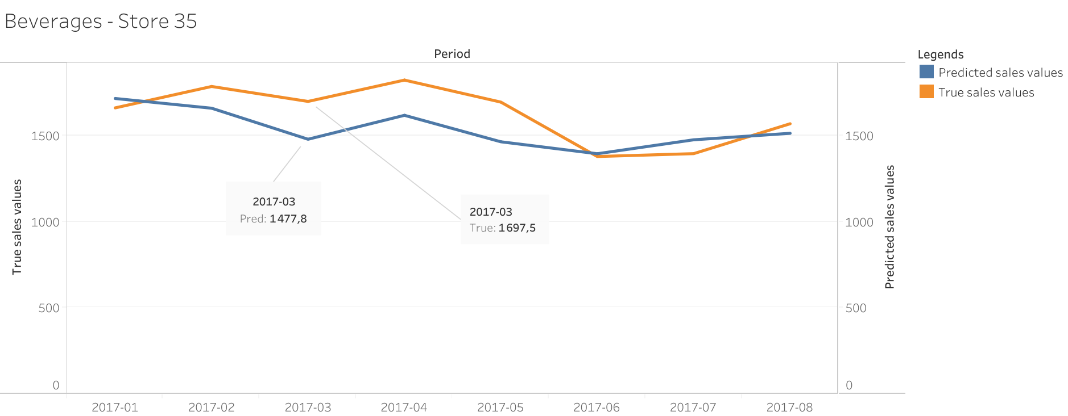
Monthly sales forecast at different stores

Slide 23
Monthly sales forecast at different stores
Model performance for “BEVERAGES” category by store
Error percentage % | Model accuracy
5 | 20.51
10 | 44.99
15 | 63.64
20 | 78.32

Slide 24
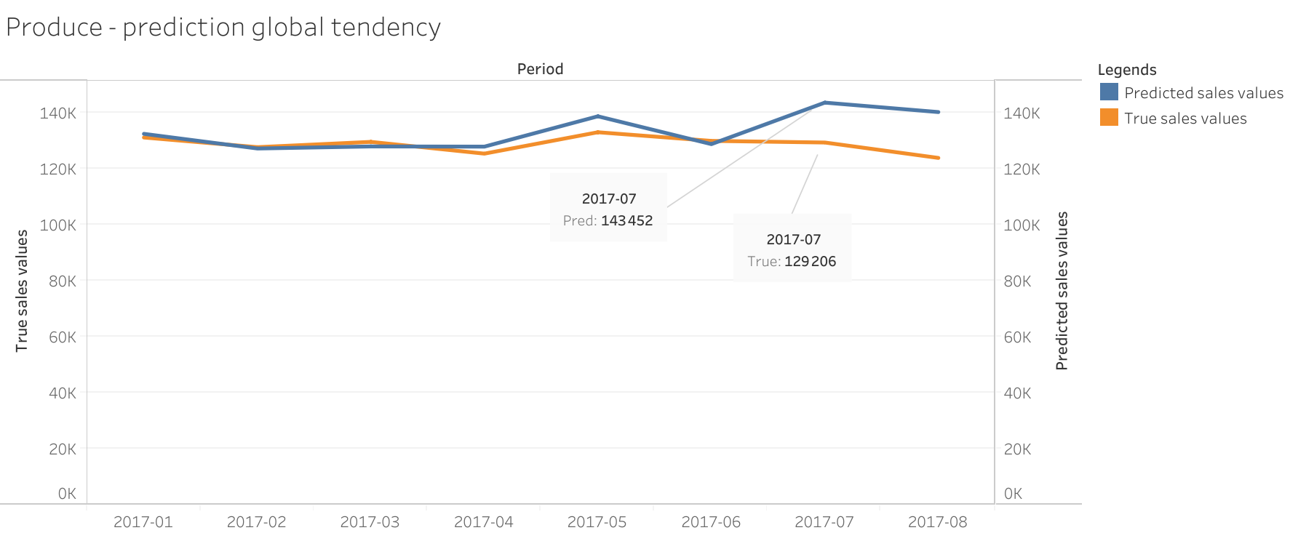
Monthly sales forecast at different stores

Slide 25
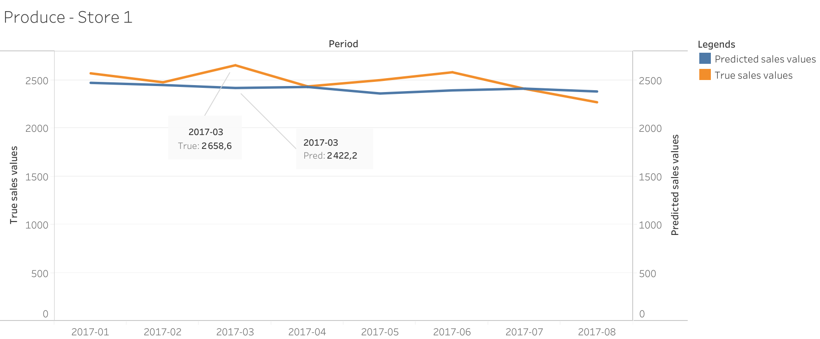
Monthly sales forecast at different stores

Slide 26
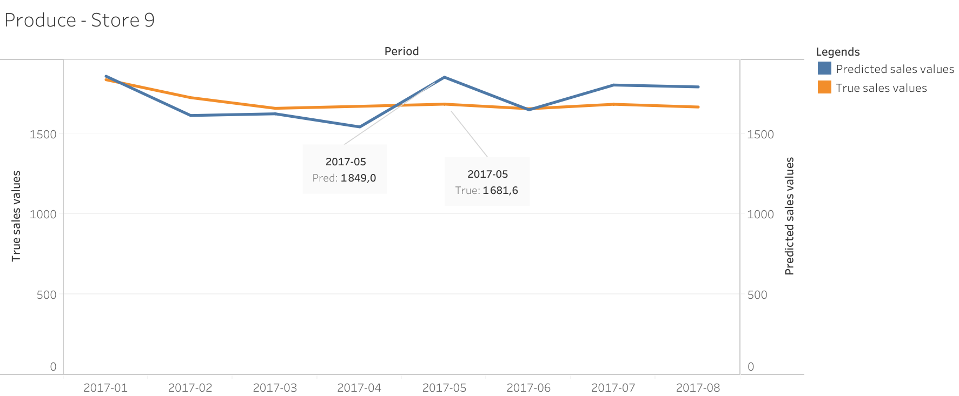
Monthly sales forecast at different stores

Slide 27
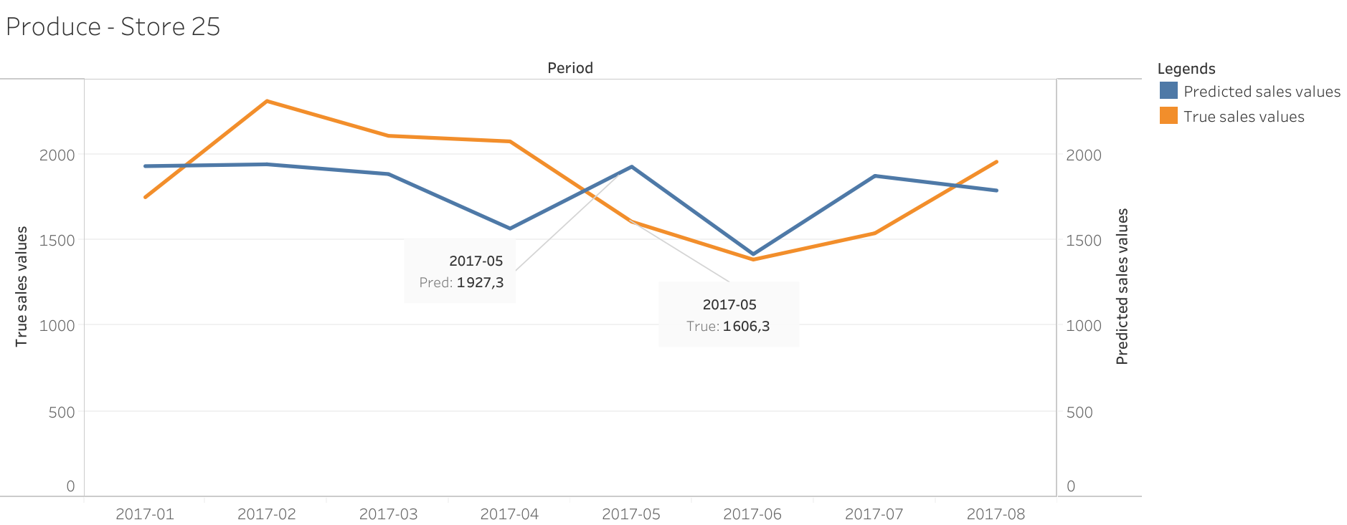
Monthly sales forecast at different stores

Slide 28
Monthly sales forecast at different stores
Model performance for “PRODUCE” category demand by store
Error percentage % | Model accuracy
5 | 40.56
10 | 59.67
15 | 71.56
20 | 76.45

Slide 29
Monthly sales forecast at different stores
Model performance on predicting monthly sales at each store for financial planning
Error percentage % | Model accuracy
5 | 28.67
10 | 57.81
15 | 69.68
20 | 78.79
30 | 90.21
Monthly
sales
by store

Slide 30
Monthly sales forecast at different stores
Model performance on predicting monthly sales for remaining categories at each store for transportation planning
Error percentage % | Model accuracy
5 | 25.34
10 | 45.69
15 | 61.32
20 | 72.31
Each category of product at each store

Slide 31
Daily sales

Slide 32
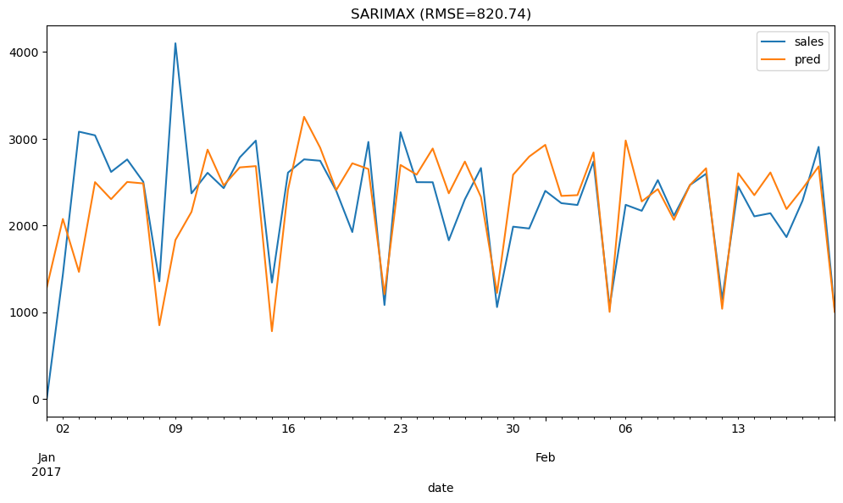
Daily sales forecast at different stores
SARIMAX model with no period lead time for “BEVERAGES” category

Slide 33
Daily sales forecast at different stores
Model performance on predicting daily sales for “BEVERAGES” category at each stores
Error percentage % | Model accuracy
5 | 28.19
10 | 48.90
15 | 66.96
20 | 75.77

Slide 34
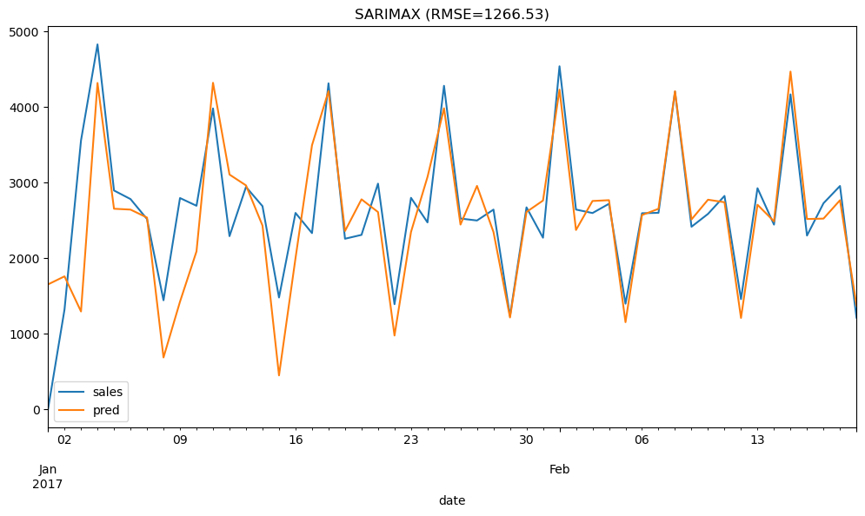
Daily sales forecast at different stores
SARIMAX model with no lead time period for “PRODUCE” category

Slide 35
Daily sales forecast at different stores
Model performance on predicting daily sales for “PRODUCE” category at each stores
Error percentage % | Model accuracy
5 | 28.63
10 | 54.19
15 | 70.48
20 | 79.30

Slide 36
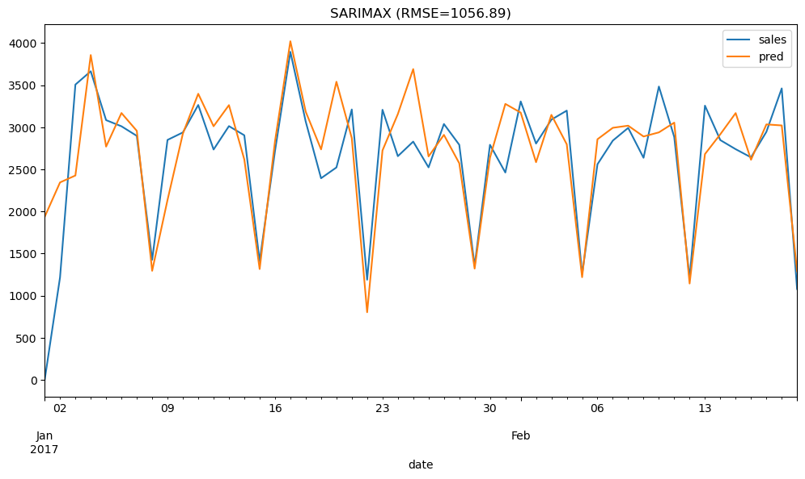
Daily sales forecast at different stores
SARIMAX model with no lead time period for “GROCERY I” category

Slide 37
Daily sales forecast at different stores
Model performance on predicting daily sales for “PRODUCE” category at each stores
Error percentage % | Model accuracy
5 | 28.63
10 | 51.54
15 | 67.84
20 | 78.41

Slide 38
Improvement on the model
More information on the dataset to handle missing and low values. Those values decrease the model accuracy.
Case by case analysis. Some series have incompatible behaviors that requires different types of features engineering.

Slide 39

Thank you for your time

